Slide 1
Terraform init
ow

Slide 2
Overview
The terraform init command initializes a working directory containing Terraform configuration files.
This is the first command that should be run after writing a new Terraform configuration or cloning an existing one from version control.
It is safe to run this command multiple times.

Slide 3
Terraform init
Purpose: terraform init initializes a Terraform working directory, setting up the necessary components for managing infrastructure using Terraform.
Usage: Open a terminal, navigate to your Terraform project directory, and run terraform init.
Example Scenario: Suppose you have a project where you want to provision and manage AWS EC2 instances using Terraform. After setting up your project directory and creating the necessary Terraform files, you run terraform init to initialize the working directory. This command performs the following tasks:
Downloads the required provider plugins, such as the AWS provider plugin, to interact with the AWS platform.
Sets up the local Terraform environment, including creating a .terraform directory to store downloaded plugins and other necessary files.

Slide 4
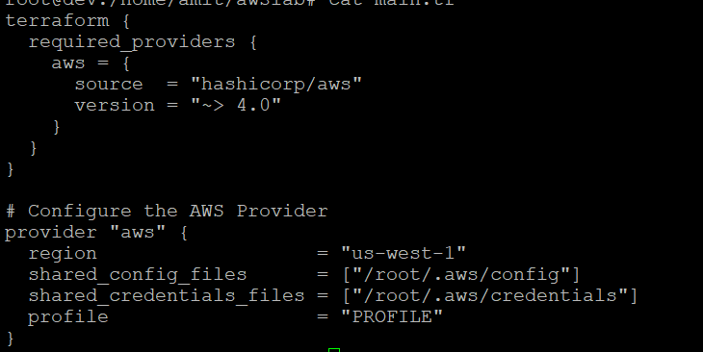
..

Slide 5
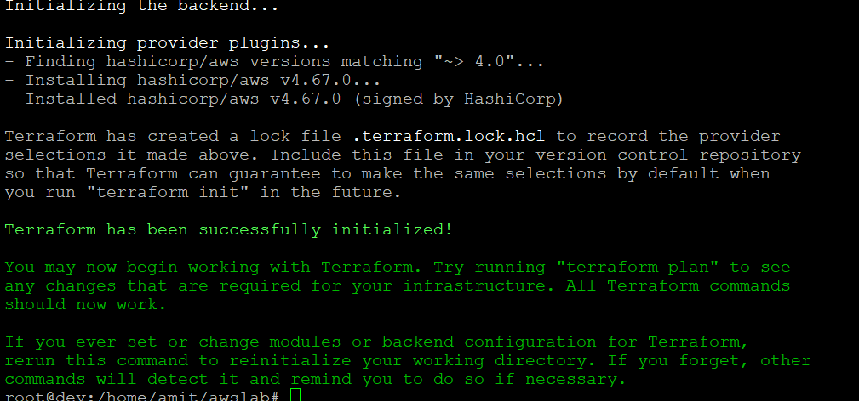
..

Slide 6
What happens when init starts
Creates a file .terraform.lock.hcl
provider "registry.terraform.io/hashicorp/local" {
version = "2.4.0"
hashes = []
This file is maintained automatically by "terraform init".
# Manual edits may be lost in future updates.

Slide 7
terraform plan
Purpose: terraform plan generates an execution plan that describes the changes Terraform will make to your infrastructure resources based on the current configuration files.
Usage: After running terraform init, navigate to your project directory in the terminal and execute terraform plan.
Example Scenario: Continuing from the previous example, suppose you have defined your infrastructure configuration in Terraform files and have initialized the working directory. Running terraform plan will perform the following actions:
Reads the configuration files and the current state of your infrastructure (from the state file).
Analyzes the differences between the current state and the desired state defined in the configuration files.
Generates an execution plan that outlines the actions Terraform will take to reach the desired state.
Displays a detailed summary of the planned changes, including resource creation, modification, or deletion, along with any associated dependencies or warnings.
The plan is not applied at this stage; it is simply a preview of the changes that will occur.

Slide 8
terraform apply
Purpose: terraform apply applies the execution plan generated by terraform plan and makes the necessary changes to provision or modify infrastructure resources.
Usage: After reviewing the plan generated by terraform plan, execute terraform apply to apply the changes.
Example Scenario: After running terraform plan and reviewing the plan, you can proceed with applying the changes by executing terraform apply. Here's what happens when you run this command:
Terraform prompts for confirmation before proceeding with the execution plan.
If confirmed, Terraform proceeds with provisioning or modifying the infrastructure resources according to the plan.
The changes are made to align the infrastructure with the desired state defined in the configuration files.
Terraform updates the state file to reflect the new state of the infrastructure after the changes have been applied.
Detailed output is displayed, showing the resources created, modified, or deleted.
Any required provider authentication is performed during the apply process.

Slide 9
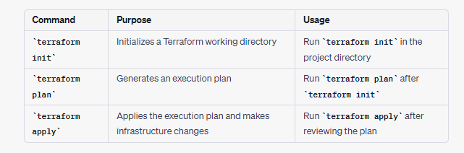
Difference

Slide 10
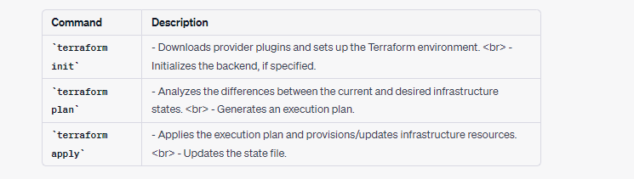
Summary

